Slide 1
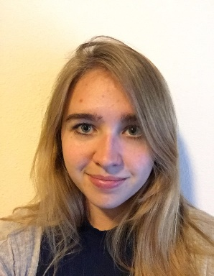
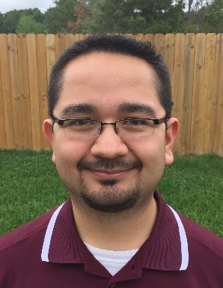
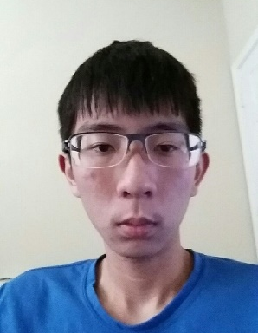

Project Avalanche
Team Booyah (Team 19)
Mario Aguilar Margaret Baxter
Patrick Quach Christine Russell

Slide 2
Introduction
Extend functionality of Project SkiLift
Create an Android GUI
Develop using Android Studio
Make use of SQLite and SPI
Practice using Agile development principles and practices (Scrum)
Practice presenting work to others in a public setting

Slide 3
Technical aspects
Project Avalanche will:
Run on an Android device
Run season simulations
Give predictions based on Power Ranking, Bayes, and Pi Rating prediction algorithms
Get predictions internally through the use of a Service Provider Interface
Uses SQLite as its DBMS
Seek to take advantage of distinct mobile device functionality

Slide 4
Code Snippet

Slide 5
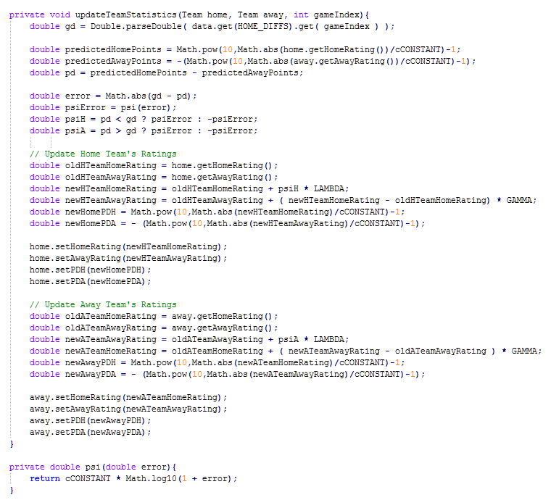
Code Snippet

Slide 6
Code Snippet

Slide 7
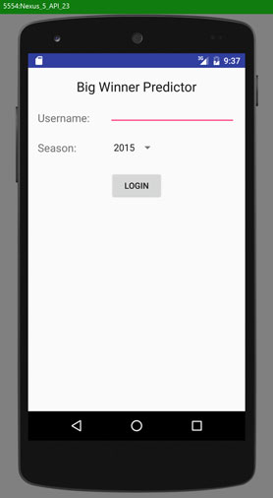
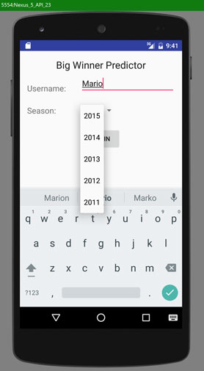
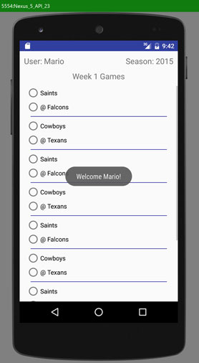
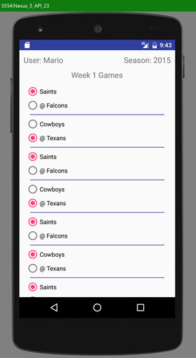
Screenshots (First Test App)

Slide 8
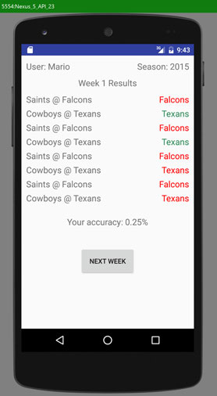
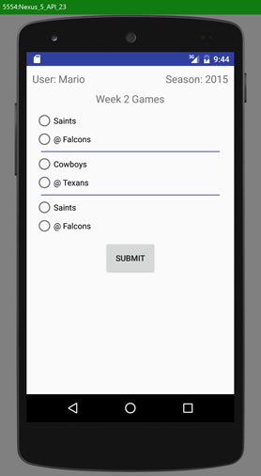
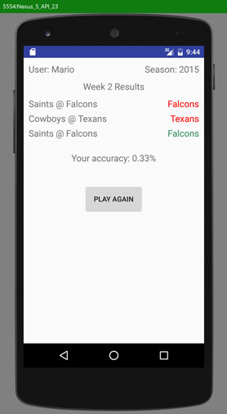
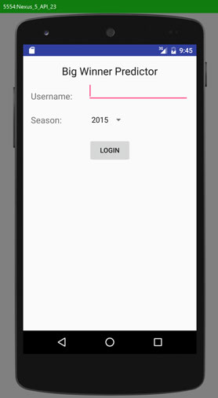
Screenshots (First Test App)

Slide 9
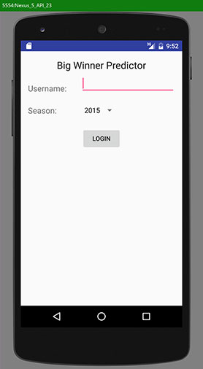
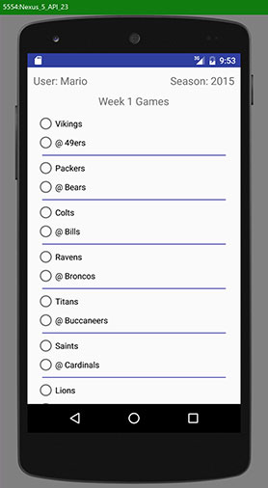
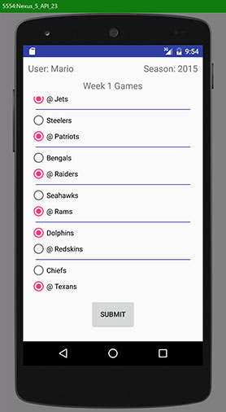
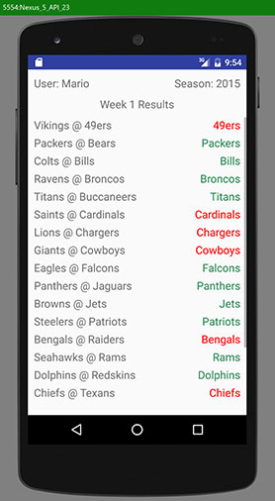
Screenshots (Second Test App)

Slide 10
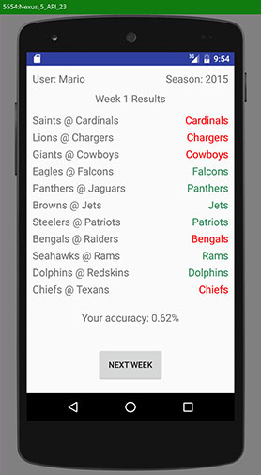
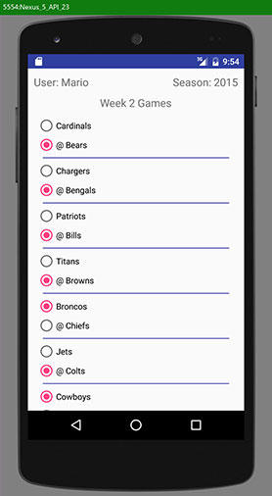
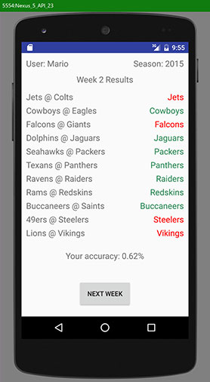
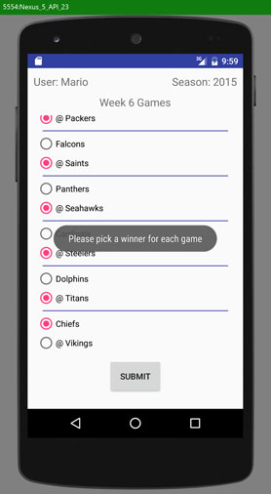
Screenshots (Second Test App)

Slide 11
Conclusion
NFL App will be expanded to include more features.
SPI Algorithms will be incorporated into the next release to give predictions.
Additional graphics will be added.

